Slide 1
Mesh Network of Realtek
2013/10/09

Slide 2
Outline
What is Mesh?
Mesh Protocol Introduction
Compiler Configuration
Mesh GUI
Mesh Demo I
Mesh Demo II

Slide 3
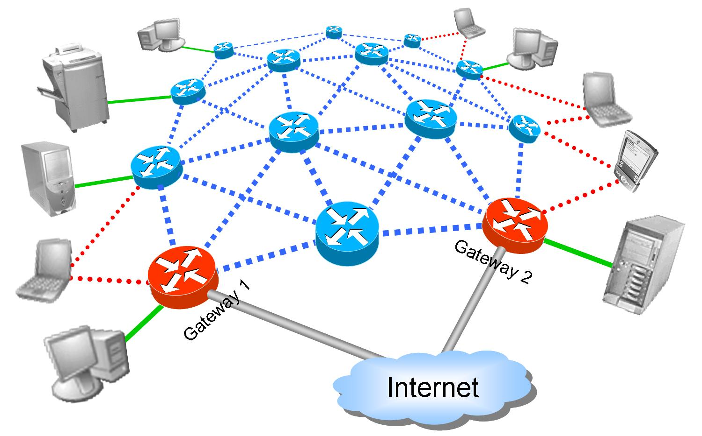



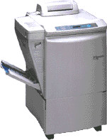



What’s Mesh? – Overview
The entire wireless mesh cloud be treated as a single (giant) Ethernet switch
Simple, fast installation
Where wires are not desired (e.g., hotels, airports)
Where wires are impossible (e.g., historic buildings)
Internet

Slide 4
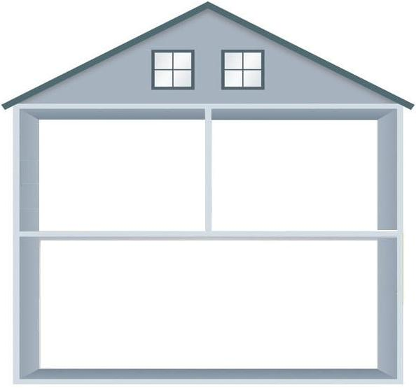

What’s Mesh? – Mesh vs. Repeater
Auto Connect
A mesh node can automatically scan nearby mesh nodes and join the mesh network without further configuration
More convenient to install
Extensible
Repeater
Mesh
D
C
D
C
A
B
A
B
ADSL
ADSL

Slide 5


What’s Mesh? – Mesh vs. Repeater (cont.)
Path Recovery
Once some error occurs on some mesh node, the mesh network can find another routing path to the destination.
More robust
No single point of failure
Repeater
Mesh
D
C
D
C
A
B
A
B
ADSL
ADSL

Slide 6
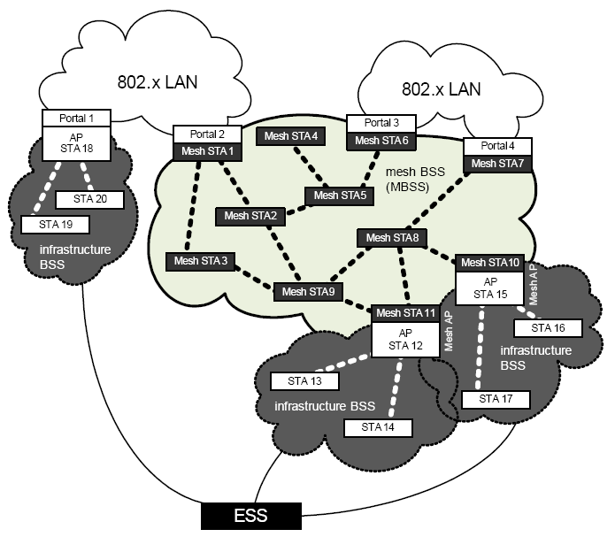
What’s Mesh? - Topology

Slide 7
What’s Mesh? - Terminology
Mesh Point (MP)
A station (STA) that implements the mesh facility. A mesh STA that operates in the mesh BSS (MBSS) may provide the distribution services for other mesh STAs.
Mesh Access Point (MAP)
A mesh station that is collocated with one or more access point(s).
Proxy Mesh Station (Portal, MPP)
A mesh STA that represents 802 entities outside the mesh basic service set (MBSS).
Peering
A logical relationship from one mesh STA to another mesh STA that has been established with the mesh peering management (MPM) protocol
Mesh Gate
A mesh station that has access to external STAs (STAs outside MBSS) called a Mesh Gate. Both MAP and MPP are Mesh Gates

Slide 8
Mesh Protocol Intro. – Discovering & Peering
Mesh nodes discover its one-hop neighbors through passive or active scan, that is listening Beacon or transmit Probe Req.
Compare mesh profile (Mesh ID), data rate, mesh capability, etc in Beacon or Probe Rsp to find candidate peer mesh STA.
Mesh nodes become “peer” (or “neighbor”) to each other through mutual association.
Each mesh nodes maintains a neighbor table
Mesh nodes can only transmit data through “neighbor”
A
C
D
E
S
B
A
B
B
E
S
D
A
C
S
B
E
C
B
C
D
E

Slide 9
Mesh Protocol Intro. – HWMP
Mesh path selection protocol - Hybrid Wireless Mesh Protocol (HWMP).
Proactive tree building mode
Gate announcement (GANN)
On demand mode (AODV)
Path request (PREQ)
Path reply (PREP)
Path error (PERR)
Each mesh node maintains a routing table, in which contains forwarding information: {destination MAC, next-hop MAC, metrics, …}

Slide 10
Mesh Protocol Intro. – HWMP(cont.)
GANN
Used to announce the presence of the mesh gate.
Mesh gate broadcast GANN for every 3 second.
dst | next | metric
S | S | 2
dst | next | metric
S | S | 2
dst | next | metric
S | A | 5
dst | next | metric
S | C | 4
dst | next | metric
S | C | 4
A
3
B
2
2
1
D
S
5
dst | next | metric
S | E | 8
dst | next | metric
S | B | 6
3
2
3
C
E
dst | next | metric
S | S | 3
dst | next | metric
S | S | 3
dst | next | metric
S | C | 6
dst | next | metric
S | C | 6

Slide 11
Mesh Protocol Intro. – HWMP(cont.)
dst | next | metric
C | C | 1
A | A | 3
D | D | 2
E | D | 4
S | C | 4
dst | next | metric
C | B | 4
B | B | 3
D | B | 5
E | B | 7
S | S | 2
dst | next | metric
C | B | 3
B | B | 2
A | B | 5
E | E | 7
S | B | 6
A
3
B
2
2
D
S
1
dst | next | metric
C | C | 3
B | C | 4
D | C | 6
E | C | 6
A | A | 2
5
3
2
3
C
E
dst | next | metric
A | B | 4
B | C | 1
D | B | 3
E | E | 3
S | S | 3
dst | next | metric
C | C | 3
B | D | 4
D | D | 2
A | C | 7
S | C | 6

Slide 12
Mesh Protocol Intro. – HWMP(cont.)
AODV
Source node broadcast a PREQ frame flooding to all mesh nodes
Ever PREQ received, mesh node(s) create a reverse path to source
When some mesh node knows destination, reply unicast PREP to source mesh node
A
PREQ
B
PREQ
PREQ
PREP
PREQ
S
PREP
D
PREQ
PREP
PREQ
PREQ
C
PREQ
E

Slide 13

Mesh Protocol Intro. – Interworking with the DS
When two STAs behind mesh gates (external STA ) need to communicate with each other.
Each mesh gate maintains a proxy table, in which contains proxy information { external STA’s address, proxy mesh gate’s address, …}
If the proxy information does not exist, do AODV first.
These proxy information is carried by PREP, or PUX (proxy update) packet.
sta | owner
STA2 | D
A
PREQ
B
sta | owner
STA2 | D
PREQ
PREP
PREQ
Mesh gate
S
Mesh gate
PREP
D
PREQ
PREQ
PREP
PREQ
PREQ
C
PREQ
E
STA1
sta | owner
STA2 | D
STA2

Slide 14
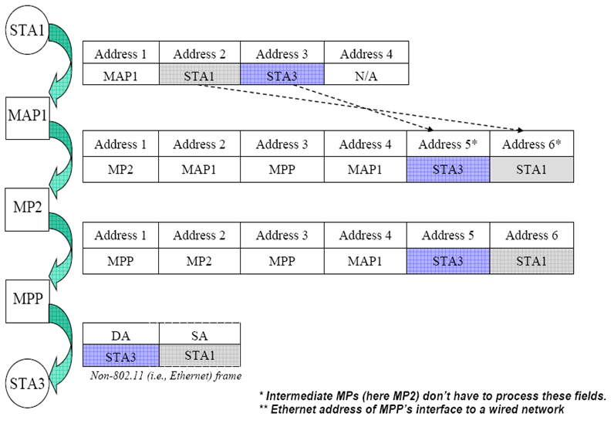
Data Forwarding – Address transform
Ref. proxy table

Slide 15
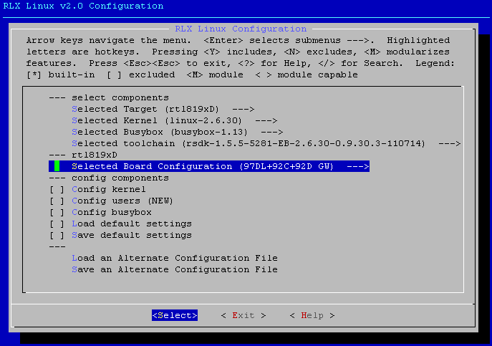
Compiler Configuration – Select Board

Slide 16
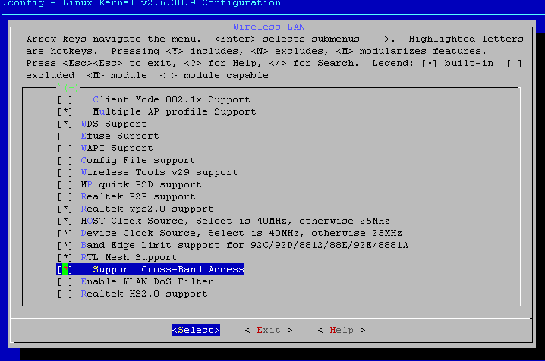
Compiler Configuration – Config Kernel
Device Drivers -> Network device support -> Wireless LAN

Slide 17
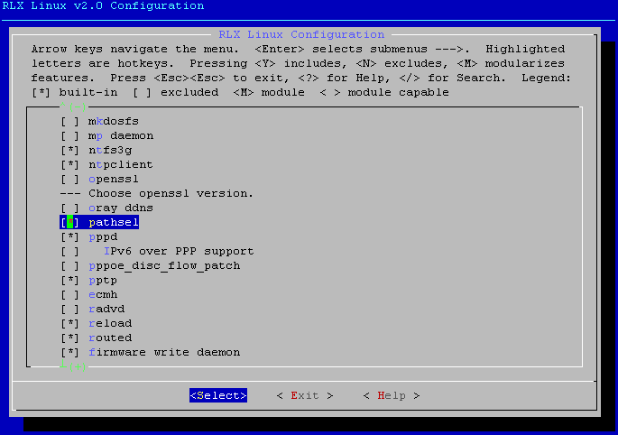
Compiler Configuration – Config Users

Slide 18
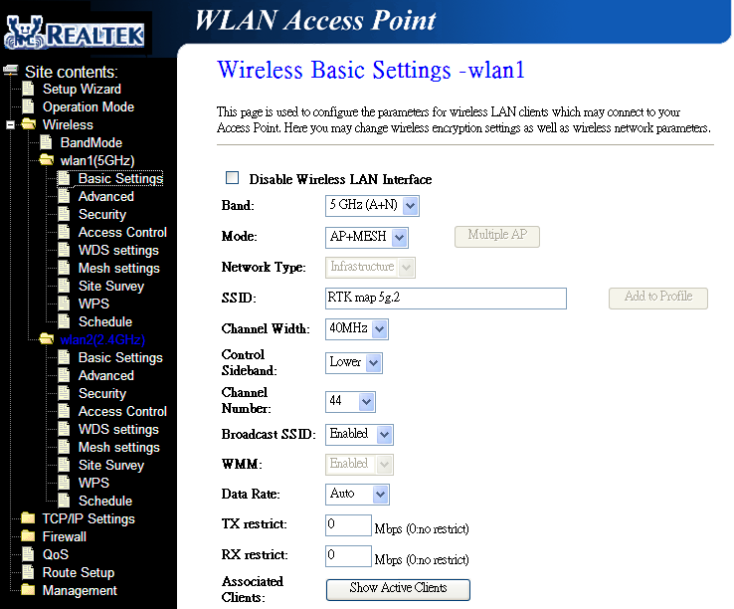
Mesh GUI – Mesh Setup

Slide 19
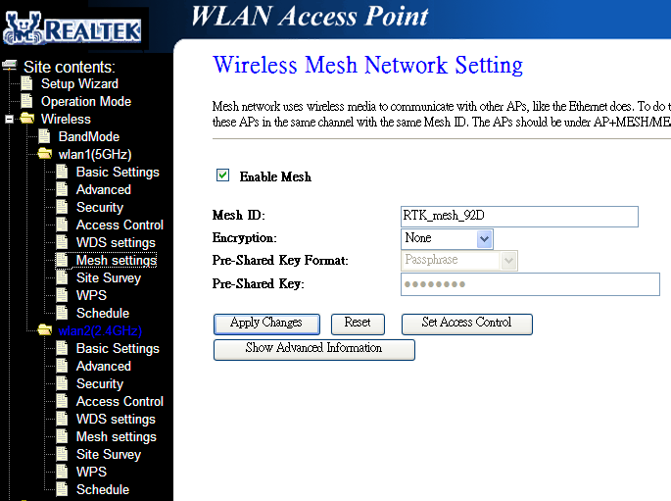
Mesh GUI – Mesh Setup (cont.)

Slide 20
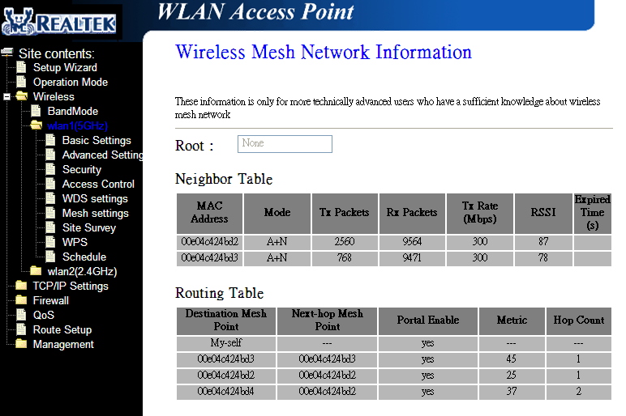
Mesh GUI – Mesh Information
c2
c4
c1
c3

Slide 21
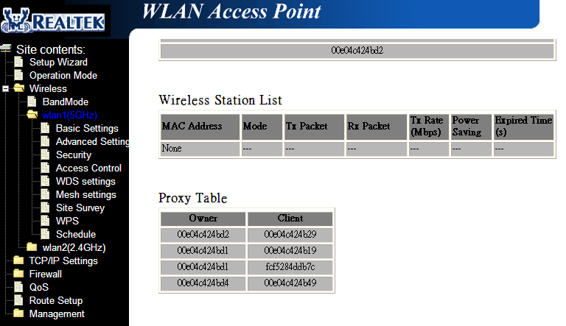
Mesh GUI – Mesh Information (cont.)

Slide 22

Mesh DEMO I
Auto Connect
1. Power on MAP1 and connect STA1 to it (Ethernet)
2. After the MAP1 has chosen an available channel, power on the other three MAPs
3. Connect STA2 to MAP4 (wireless)
4. Ping all MAPs and STA2 from STA1
MAP2
Ping
MAP4
ACL Denied
STA2
MAP1
STA1
MAP3

Slide 23
Mesh DEMO II
Path Recovery
1. Power off MAP2
2. Check if STA1 can communicate with STA2
3. Power on MAP2 again
4. Check if the routing path from MAP1 to MAP4 has changed from MAP1-MAP3-MAP4 to MAP1-MAP2-MAP4
MAP2
Ping
MAP4
ACL Denied
STA2
MAP1
STA1
Ping
MAP3

